Slide 1
Master Client – Data Visualization

Slide 2
Coke Vs Pepsi Split By State
Coke has the high share in MO, NM, MI and MN
Pepsi shows relative strength ME (100% share) and CA (around 50%)
There are a few states where only Pepsi is poured are ME, NY, CT, OR, NV, AZ and VT
Coke dominates nationwide, but Pepsi is strong in selected states only

Slide 3
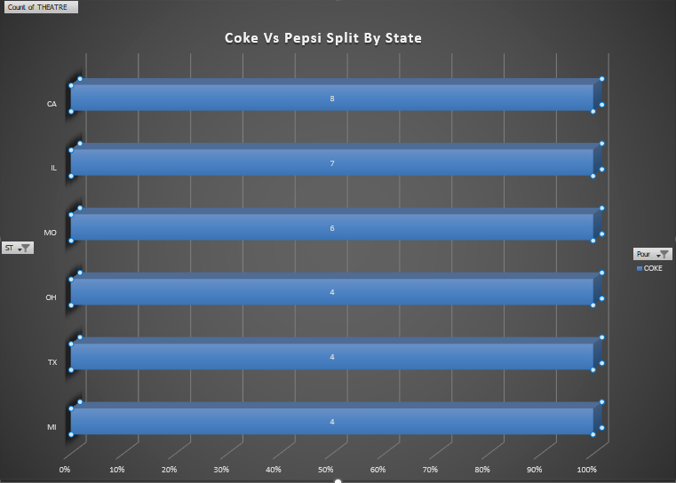
Top 5 states that pour Coke
COKE dominates in states such as California, Texas, Michigan, and Illinois, where theater networks and DMB installations are the highest. This reflects strong brand loyalty and established partnerships in these markets. By focusing on localized digital content creation and enhancing Coke’s visibility across these high-performing regions, we can further strengthen our partnership with Coke in the cinema experience.

Slide 4
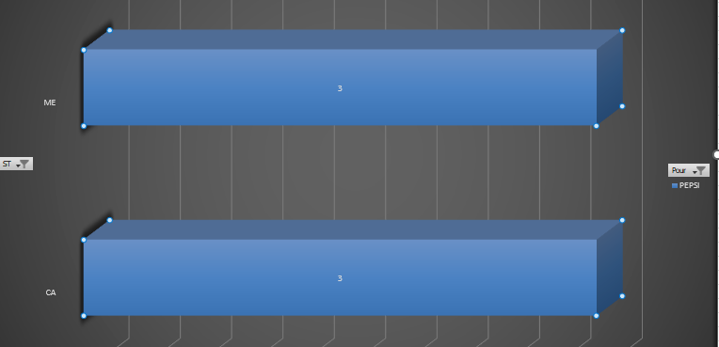
Top 2 states that pour Pepsi

Slide 5
Coke Vs Pepsi Share Across All Theaters
Coke leads with approximately 70% (69 of 113) of the overall share across 113 theaters. Suggest coke as a dominant choice for most theaters
Pepsi only holds about approximately 30% (35 of 113) of the overall share across total theaters

Slide 6
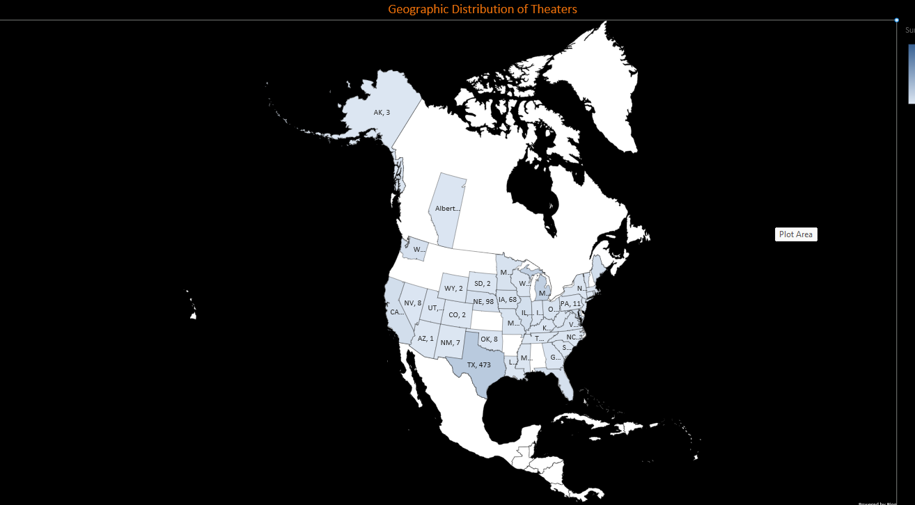

Geographic Distribution of Theaters
Theater screens are highly concentrated in southern and midwestern regions
Western and Mountain states such as (Nevada, Colorado) has limited penetration

Slide 7
Top States by Theater Screens
Texas (TX) and Michigan (MI) are the largest markets with about 473 and 369 screens respectively. So, together they account for over 35% of all the screens
Several states fall below 50 screens
Useful for targeting the state specific events/conference where we can increase our reach.

Slide 8
Screen and DMB distribution by Theater Chain
Emagine Entertainment has the highest number of DMB but less number of screens compared to Santikos
Also, Santa Rosa Cinema and Phoenix Theaters have more DMBs compared to screens, so it shows that it has a great potential for digital marketing or digital assets production

Slide 9
Top 5 states by screens and DMB’s distribution
This chart will help our team to identify where to focus on which states for the digital assets production
Texas and California have the highest number of DMB’s so these states will require more frequent content to update

Slide 10
Insights
Coke vs Pepsi Performance
Coke maintains clear market leadership, holding approximately 70% share (69 of 113 theaters), making it the dominant beverage partner across the network.
Pepsi holds 30% (35 of 113 theaters), showing a smaller portion of our network.
Coke dominates in key states such as California, Texas, Michigan, and Illinois, where theater networks and digital menu board (DMB) installations are strongest, reflecting brand loyalty and established partnerships.
Pepsi shows relative strength in specific markets such as Maine (100% share) and California (approx 50%), indicating regional influence.
States where only Pepsi is poured include Maine, New York, Connecticut, Oregon, Nevada, Arizona, and Vermont, highlighting limited but exclusive territories for the brand.
Overall, Coke dominates nationwide, while Pepsi’s presence remains localized to select states.
Focus digital content creation in Coke-dominant states (CA, TX, MI, IL) to reinforce brand leadership and maintain high visibility.
Theater & Screen Distribution
Texas (473 screens) and Michigan (369 screens) are the largest theater markets, together accounting for over 35% of all screens.
Theater screens are highly concentrated in southern and midwestern states, with limited penetration in western and mountain states such as Nevada and Colorado.
Several states fall below 50 screens, to boost our visibility in these markets, we can encourage attending local events or which can be strategically targeted for local events, sponsorships, or brand activations to increase visibility in smaller markets.
We can utilize state-level screen concentration to prioritize marketing events, attending conferences and sponsorships where audience density is highest.
Digital Menu Board (DMB) Insights
Texas, Michigan, and California have the highest number of DMBs, making them priority regions for frequent digital content updates and localized creative assets.
Emagine Entertainment has the highest number of DMBs, though fewer screens compared to Santikos, suggesting stronger digital focus despite smaller scale.
Santa Rosa Cinema and Phoenix Theaters show more DMBs than screens, indicating a high level of digital readiness and strong potential for digital marketing activations.
The presence of multiple DMBs per screen highlights opportunities for more dynamic content rotation

